Slide 1


Building Research Applications with Mendeley
Opening up content discovery for your catalogue
William Gunn Head of Academic Outreach
william.gunn@mendeley.com
@mrgunn

Slide 2

The Internet is BIG
Your site is small

Slide 3
Search Engines Are Failing
Why We Desperately Need a New (and Better) Google
Dishwashers, and How Google Eats Its Own Tail
Content Farms: Why Media, Blogs & Google Should Be Worried
On the increasing uselessness of Google
Coding Horror: Trouble In the House of Google
Videk WadHwa, Techcrunch
Paul Kedrosky, Infectious Greed
Richard Macmanus, ReadWriteWeb
Alan Patrick, Broadstuff
Joe Atwood, Coding Horror
“As part of Christmas shopping for my wife, I searched for "iPhone 4 case" in Google. I had to give up completely on the first two pages of search results as utterly useless, and searched Amazon instead. “

Slide 4

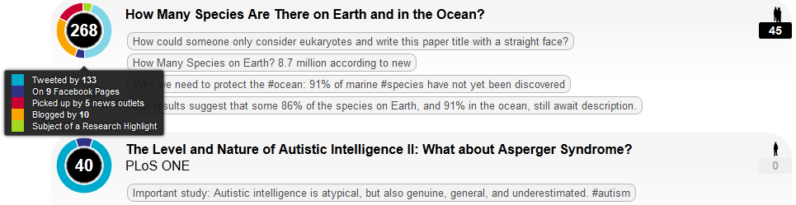
Enter Social Discovery

Slide 5
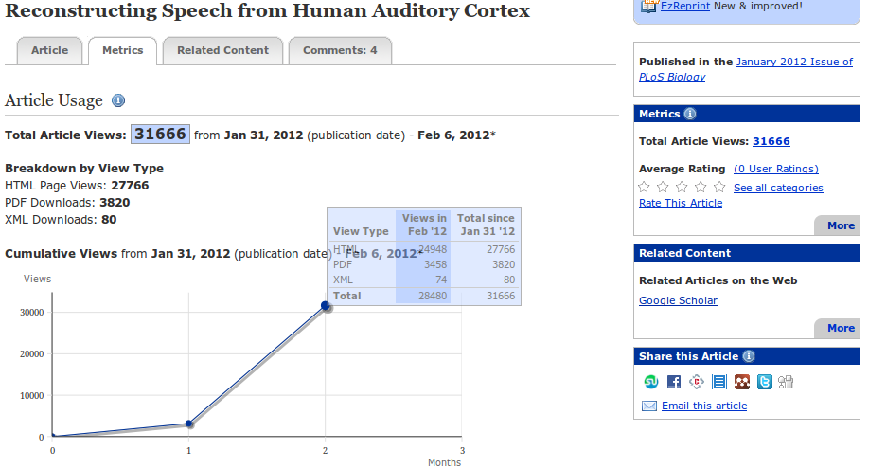
Metrics as a discovery tool

Slide 6
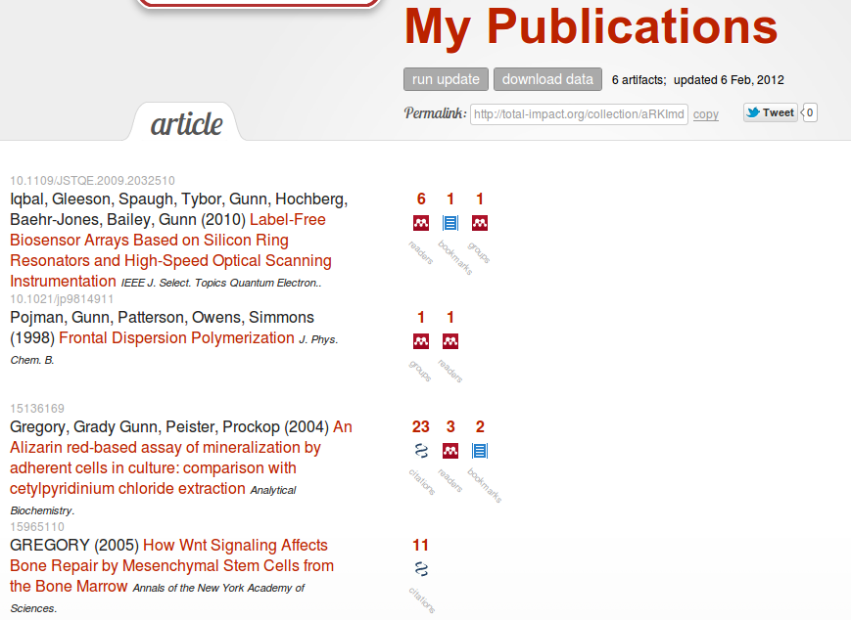

Slide 7
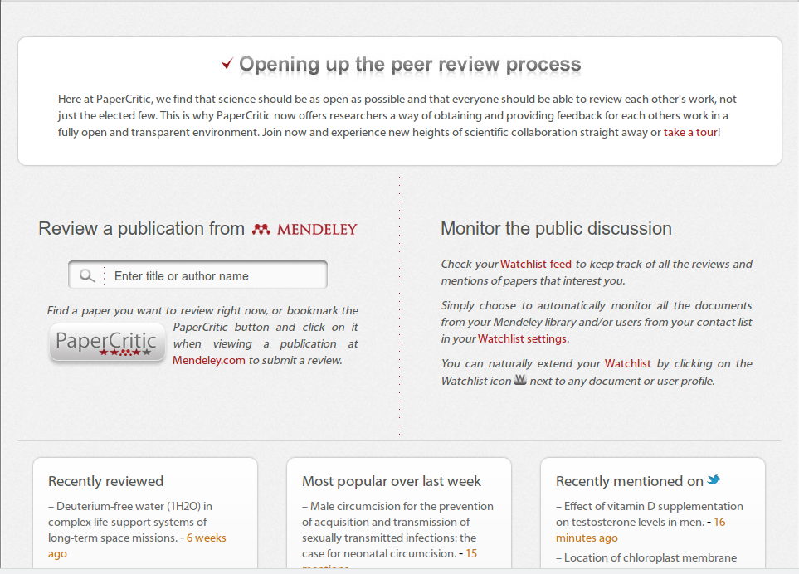

Slide 8

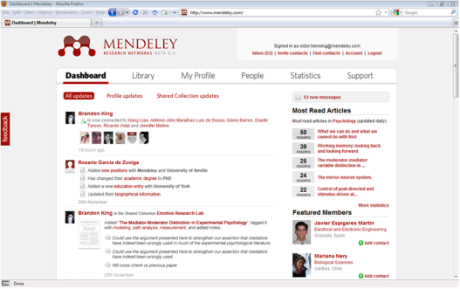




Mendeley makes science more collaborative and transparent:
...and aggregates research data in the cloud
Install Mendeley Desktop
Mendeley extracts research data…

Slide 9
What is Mendeley?
Mendeley Web: A research catalog of 160M documents from 1.6M researchers, 130K collaborative groups.
Mendeley Desktop: A bit of software that organizes PDFs and helps you write papers.

Slide 10

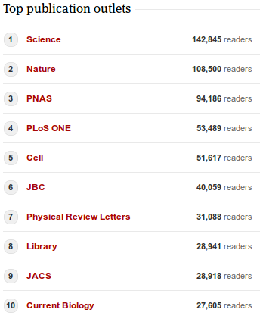
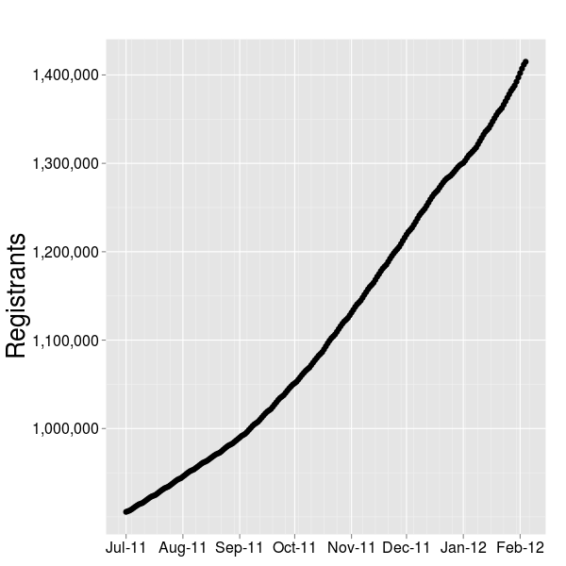
Get the content out of the silo and circulating in the wider web

Slide 11
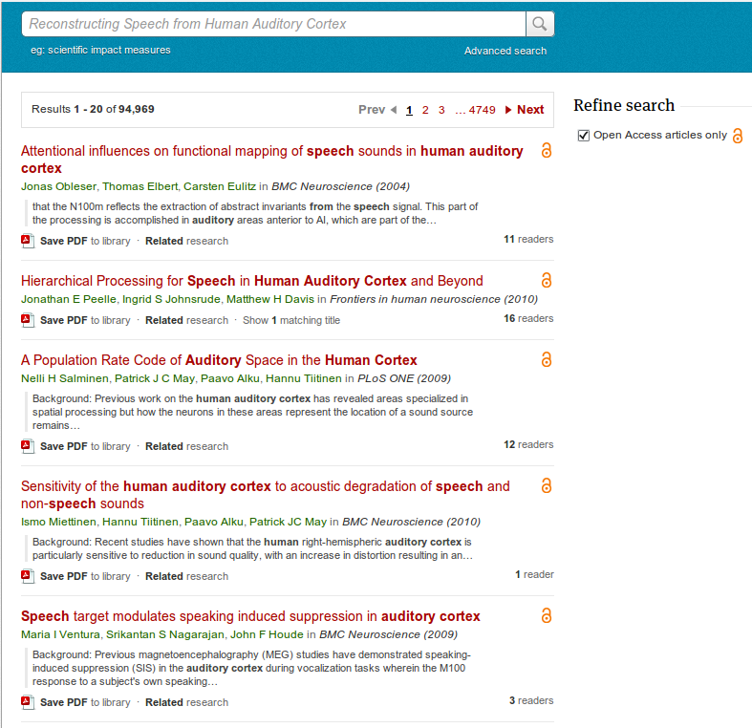
Ranking by readership at Mendeley

Slide 12
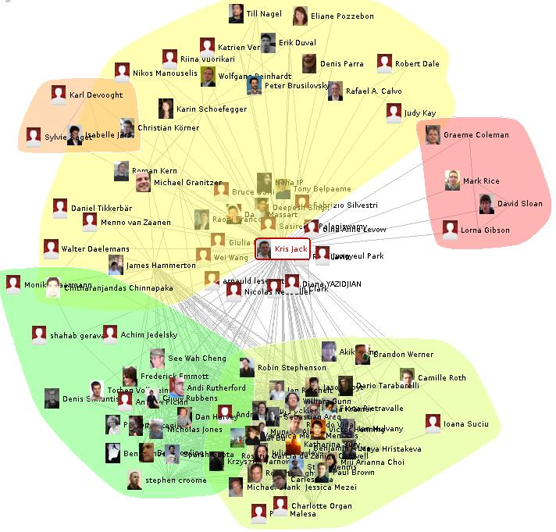

Slide 13

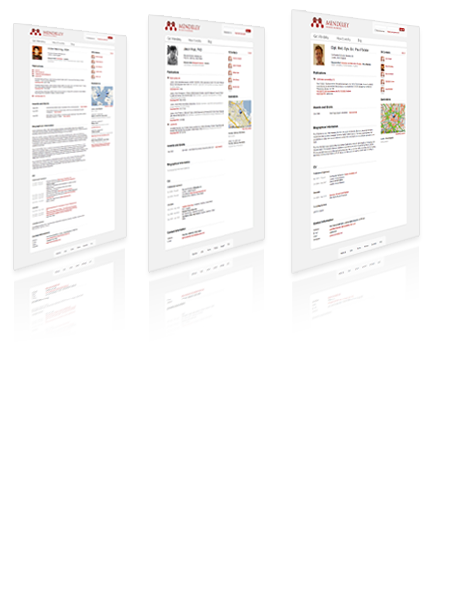

JISC DURA Project
http://jisc-dura.blogspot.com

Slide 14
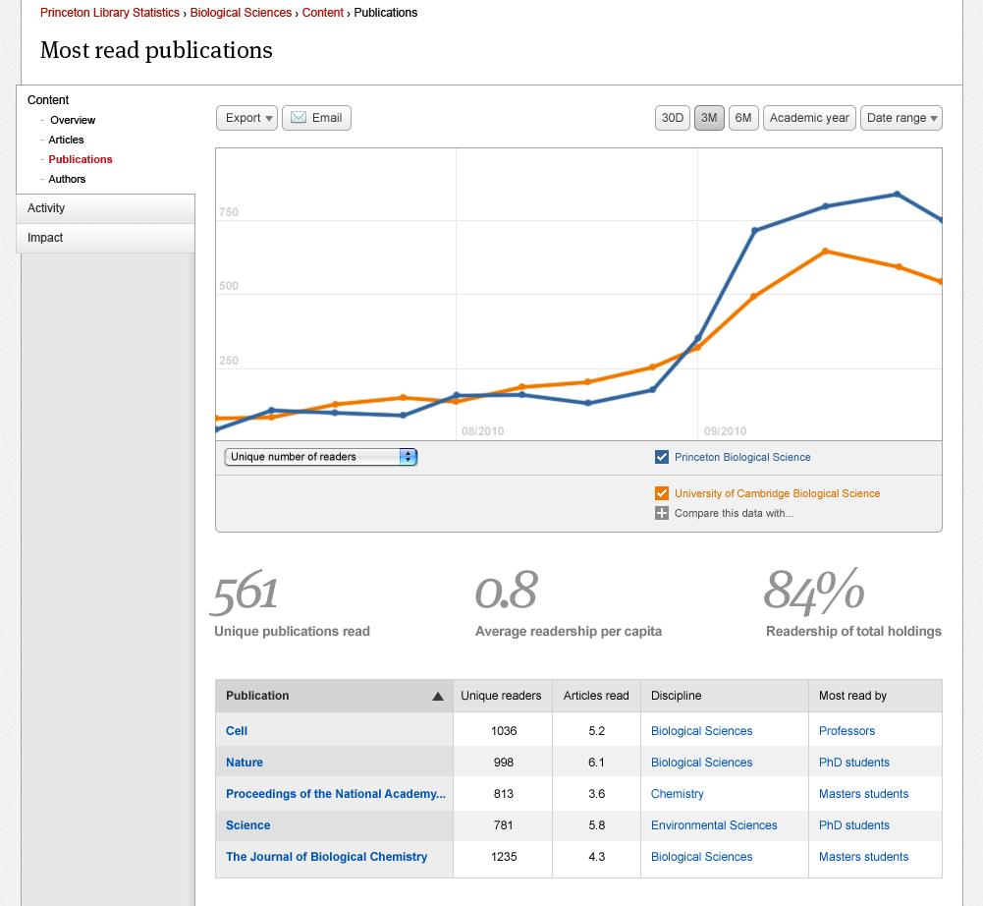
http://swets.com/mendeley
Notes:
14

Slide 15
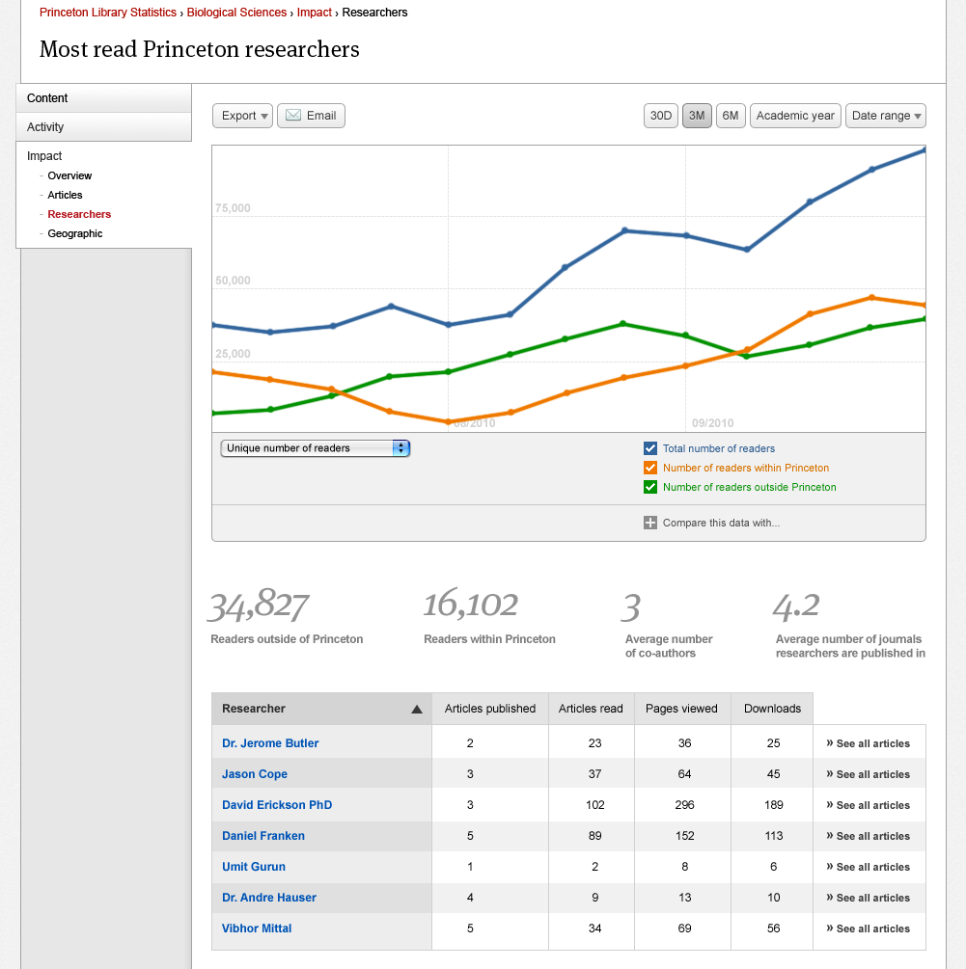
http://swets.com/mendeley
Notes:
15

Slide 16
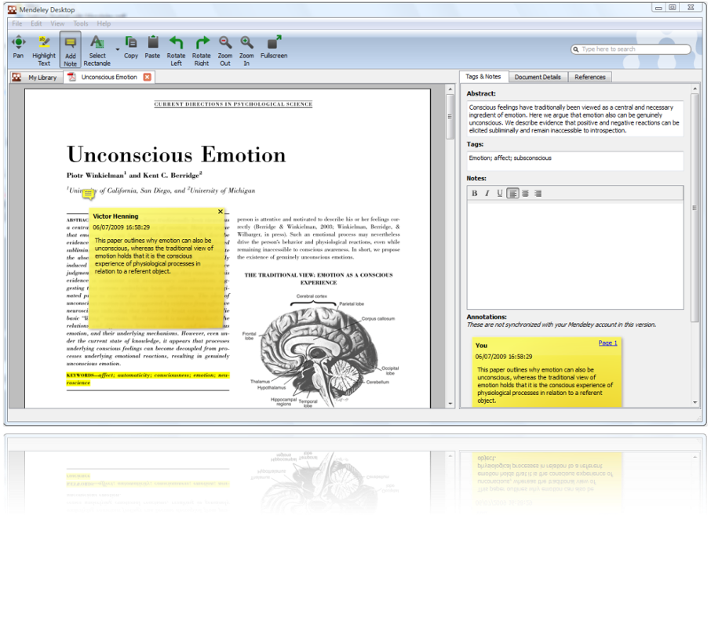

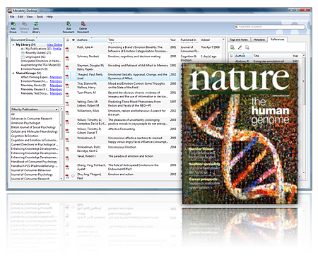
Linked Data #FTMFW
Select relation:
supports
refutes
complements
uses same method
...
Result:
A human-curated, constantly evolving semantic article database

Slide 17
www.mendeley.com
william.gunn@mendeley.com

Slide 18
http://mnd.ly/C4L2012WG
Code word: Belgian

